Slide 1
Module 3
Image Enhancement

Slide 2
Introduction Why we need image enhancement?
Images may suffer from the following degradations:
Poor contrast due to poor illumination or finite sensitivity of the imaging device
Electronic sensor noise or atmospheric disturbances leading to broad band noise
Aliasing effects due to inadequate sampling
Finite aperture effects or motion leading to spatial distortion

Slide 3
Image Enhancement Methods
Spatial Domain Methods (Image Plane)
Techniques are based on direct manipulation of pixels in an image.
Frequency Domain Methods
Techniques are based on modifying the Fourier transform of the image.
Combination Methods
There are some enhancement techniques based on various combinations of methods from the first two categories

Slide 4
Image Enhancement in the Spatial Domain
Image Enhancement: –
- To “improve” the usefulness of an image by using some transformation on the image.
-- “better” looking, such as increasing the intensity or contrast.
A mathematical representation of spatial domain enhancement:
g(x,y) = T [f(x,y)]
where f(x, y): the input image
g(x, y): the processed image
T: an operator on f, defined over some neighborhood of (x, y)

Slide 5
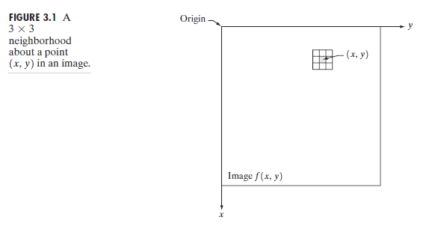
Spatial filtering
Point processing
Neighborhood processing

Slide 6
Some Basic Intensity (Gray-level) Transformation Functions(point processing functions)
simplest of all image enhancement techniques.
The value of pixels, before and after processing, will be denoted by r and s, respectively. These values are related by the expression of the form:
s = T (r)
where T is a transformation that maps a pixel value r into a pixel value s.

Slide 7
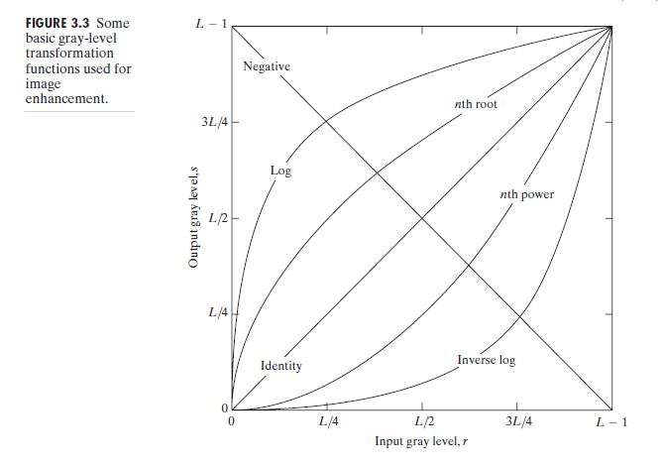
Some Basic Intensity (Gray-level) Transformation Functions continued..
The three basic types of functions used frequently for image enhancement:
Linear Functions:
Negative Transformation
Identity Transformation
Logarithmic Functions:
Log Transformation
Inverse-log Transformation
Power-Law Functions:
n^{th} power transformation
n^{th} root transformation

Slide 8
Linear Functions
Identity Function
Output intensities are identical to input intensities
This function doesn’t have an effect on an image, it was included in the graph only for completeness
Its expression:
s = r

Slide 9
Linear Functions
Image Negatives (Negative Transformation)
The gray level in the range [0, L-1], where L = Largest value in an image
the negative transformation’s expression:
s = L – 1 – r
--reverses the intensity levels of an input image,
--produces the equivalent of a photographic negative.
for enhancing white or gray detail embedded in dark regions of an image, especially when the black area are dominant in size

Slide 10
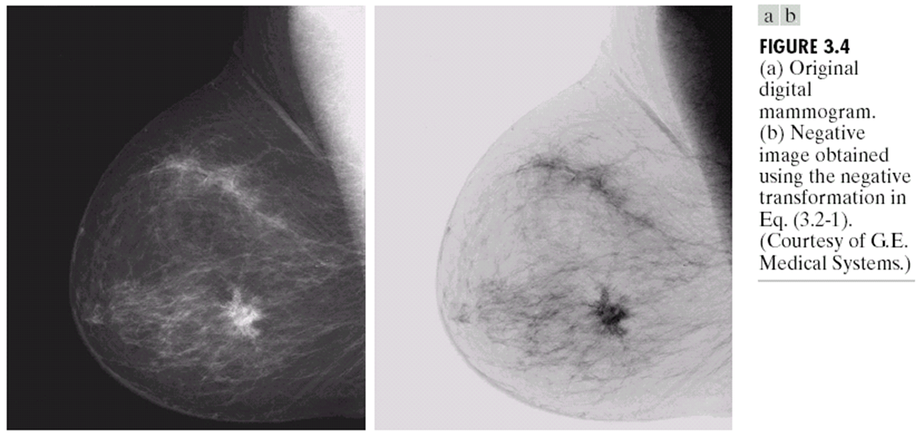

Slide 11
Logarithmic Transformations
Log Transformation
The general form of the log transformation:
s = c log (1+r)
Where c is a constant, and r ≥ 0
Log curve maps a narrow range of low gray-level values in the input image into a wider range of the output levels.
Used to expand the values of dark pixels in an image while compressing the higher-level values.
It compresses the dynamic range of images with large variations in pixel values.

Slide 13
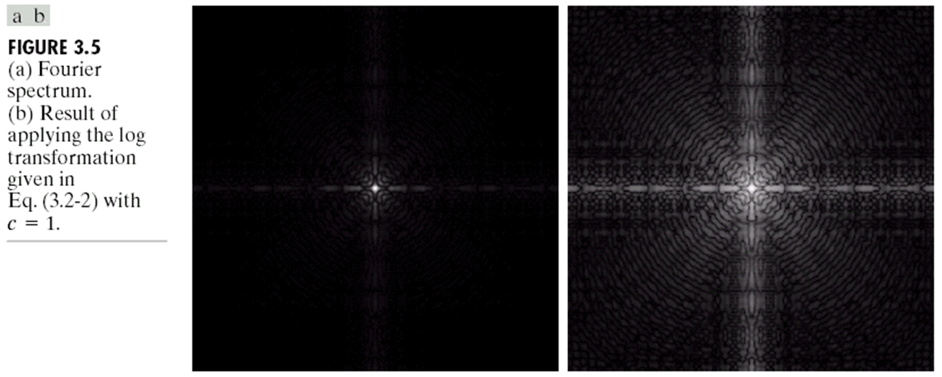

Slide 14
expand the values of high pixels in an image while compressing the darker-level values
expand the values of dark pixels in an image while compressing the higher-level values
Log
InvLog

Slide 15
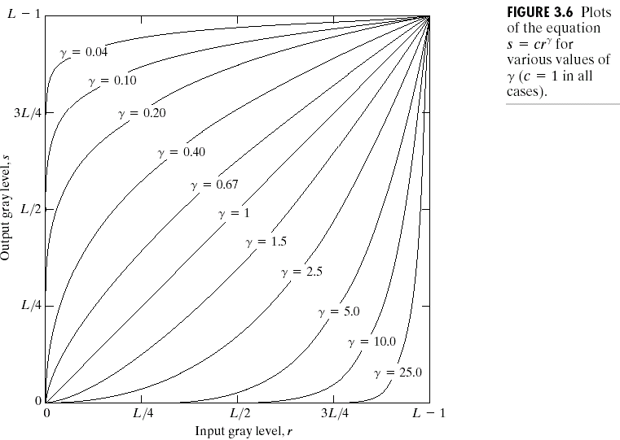
Power-Law Transformations
Power-law transformations have the basic form of:
s = c.rᵞ
Where c and ᵞ are positive constants
γ < 1
Expands dark values
Compresses bright values
γ > 1
Compresses dark values
Expands bright values

Slide 16
Power-Law Transformations
A variety of devices used for image capture, printing and display respond according to a power law.
By convention, the exponent in the power law equation is referred as gamma.
The process used to correct these power-law response phenomenon is called as gamma correction.
E.g. CRT devices have an intensity-to-voltage response that is a power function, with exponent varying from 1.8 to 2.5
With reference to the curve for gamma=2.5, the display system would tend to produce images that are darker than intended.

Slide 17
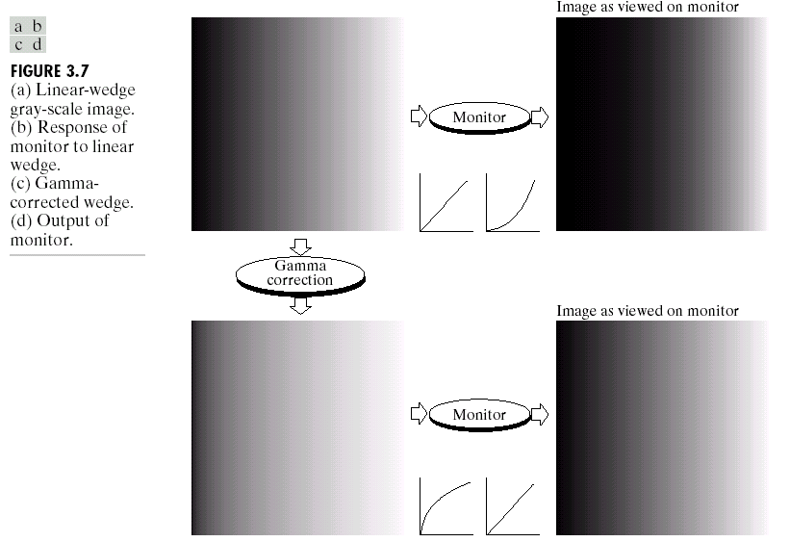
Power-Law Transformation Example 1: Gamma Correction

Slide 18
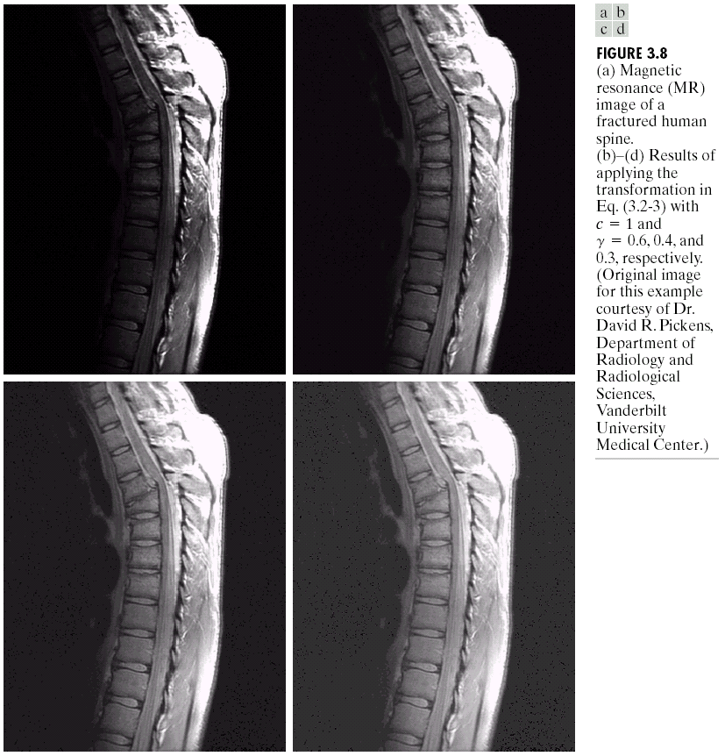
Example 2: Gamma Correction

Slide 19
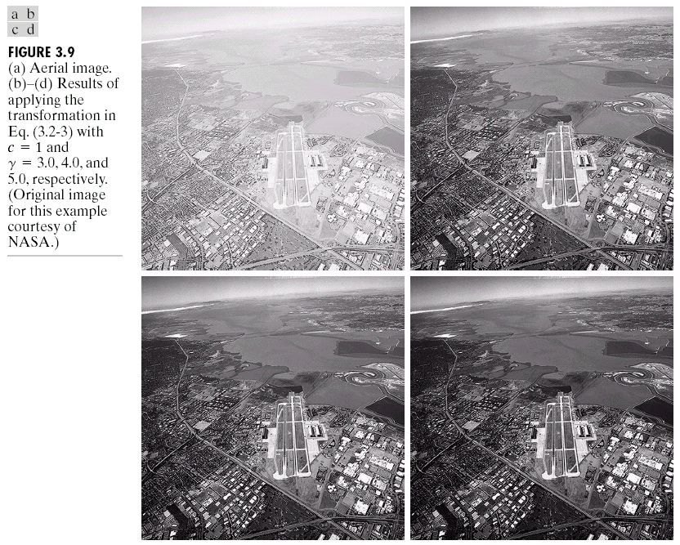
Example 3: Gamma Correction

Slide 20
Piecewise-Linear Transformation Functions
Advantage:
the form of piecewise functions can be arbitrary complex over the previous functions
Disadvantage: require considerably more user input.

Slide 21
Contrast stretching
Low contrast image result from:
1) Poor illumination
2) Lack of dynamic range in the imaging sensor
3) Wrong setting of lens aperture during image acquisition
One of the simplest piecewise function
Increase the dynamic range of the gray levels in the image
Location of (r1, s1) and (r2,s2)control the shape of the transformation function
A typical transformation: control the shape of the transformation
r₁=r₂ s₁=0 and s₂=L-1

Slide 22
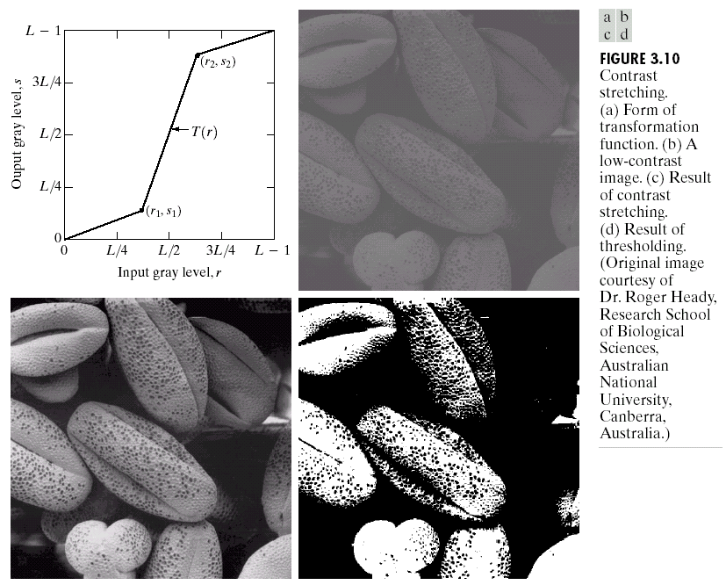
Piecewise-Linear Transformation Functions Case 1: Contrast Stretching

Slide 23
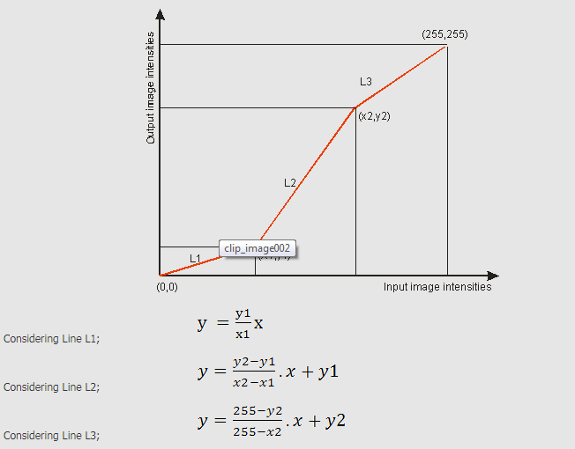

Slide 24
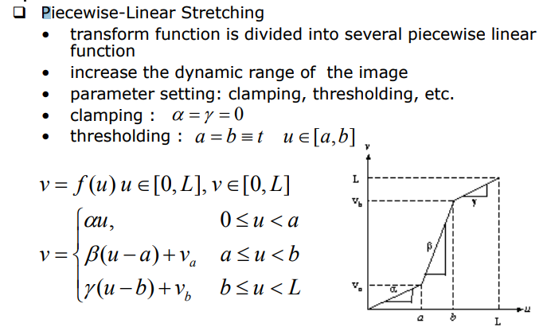

Slide 25
Case 2:Gray-level Slicing OR Intensity- level slicing
Purpose: Highlight a specific range of grey values.
Two approaches:
1) Display high value for range of interest, low value else (‘discard background’)
2) Display high value for range of interest, original value else (‘preserve background’)

Slide 26
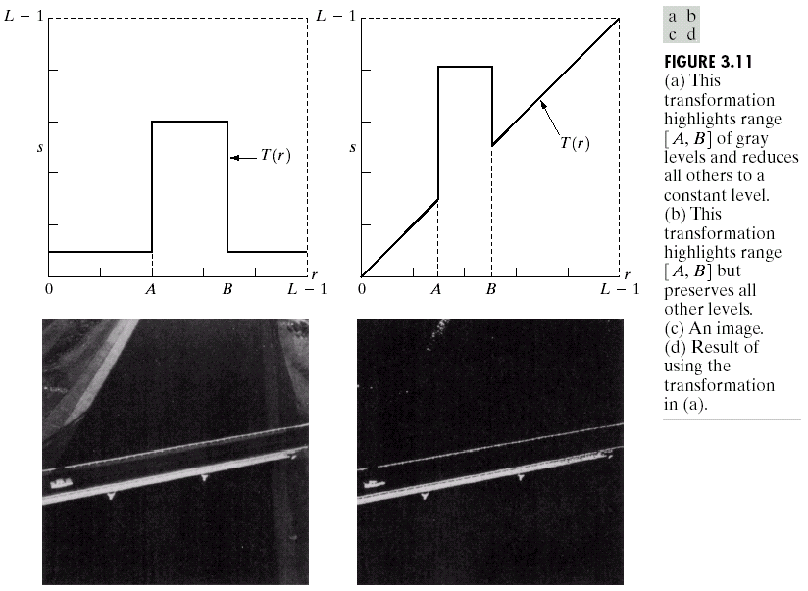

Slide 27
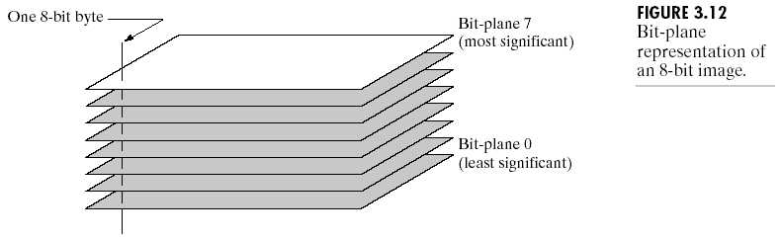
Case 3:Bit-plane Slicing
highlight the contribution made to total image appearance by specific bits.
Each pixel in an image represented by 8 bits.
Image is composed of eight 1-bit planes.
Extracts the information of a single bit plane

Slide 28
BP 0
BP 5
BP 7

Slide 29
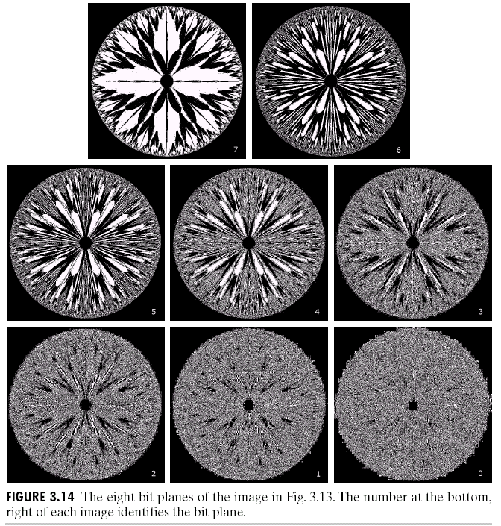

Slide 30
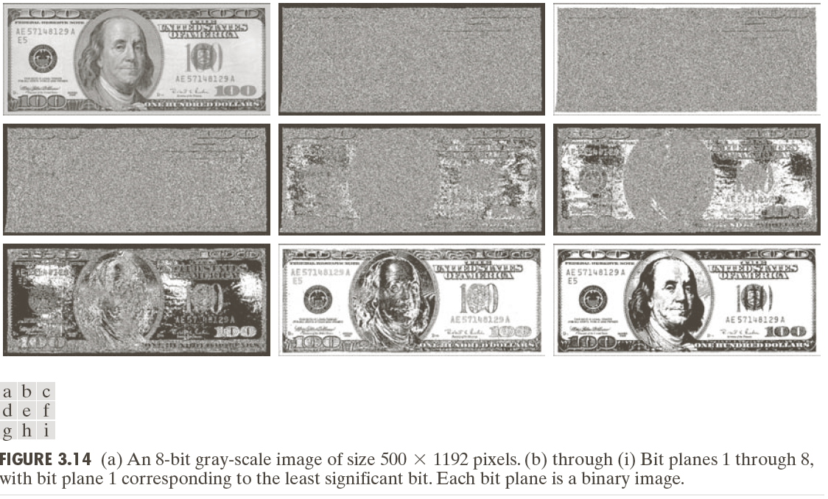

Slide 31
Advantages of bit plane slicing
It is useful for analyzing the relative importance of each bit in the image, a process that aids in determining the adequacy of the number of bits used to quantize the image.
This type of decomposition is useful for image compression in which fewer than all planes are used in reconstructing an image.
Reconstruction:
The reconstruction is done by multiplying the pixels of the nth plane by the constant 2 rest to n-1 and added all planes.

Slide 32
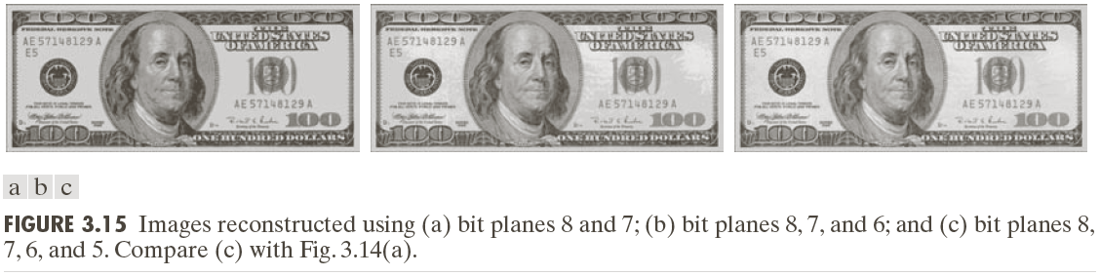

Slide 33
Neighborhood processing/ Spatial Filtering
Spatial filtering can be either linear or non-linear.
For each output pixel, some neighborhood of input pixels is used in the computation.
In general, linear filtering of an image f of size M X N with a filter mask of size m x n is given by
Where a=(m-1)/2 and b=(n-1)/2

Slide 34
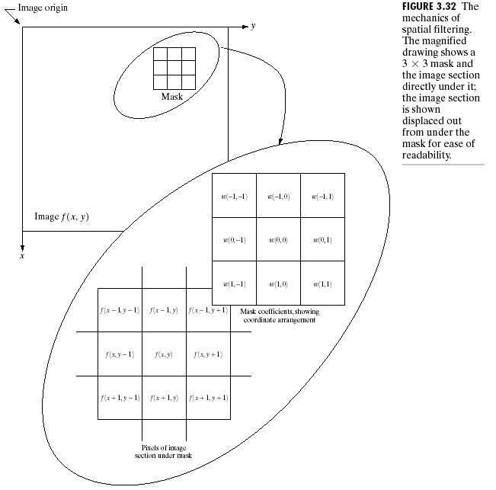
Basics of Spatial Filtering

Slide 35
The Spatial Filtering Process
Origin
x
a
b
c
j
k
l
d
e
f
*
m
n
o
g
h
i
p
q
r
Original Image Pixels
Filter (w)
Simple 3*3 Neighbourhood
e
3*3 Filter
e_{processed} = n*e + j*a + k*b + l*c + m*d + o*f + p*g + q*h + r*i
y
Image f (x, y)
The above is repeated for every pixel in the original image to generate the filtered image

Slide 36
Strange Things Happen At The Edges!
At the edges of an image we are missing pixels to form a neighbourhood
Origin
x
e
e
e
e
e
e
e
y
Image f (x, y)

Slide 37
Strange Things Happen At The Edges! (cont…)
There are a few approaches to dealing with missing edge pixels:
Omit missing pixels
Only works with some filters
Can add extra code and slow down processing
Pad the image
Typically with either all white or all black pixels
Replicate border pixels
Truncate the image

Slide 38
Correlation and Convolution
Filter masks are sometimes called convolution masks or convolution kernels.

Slide 39
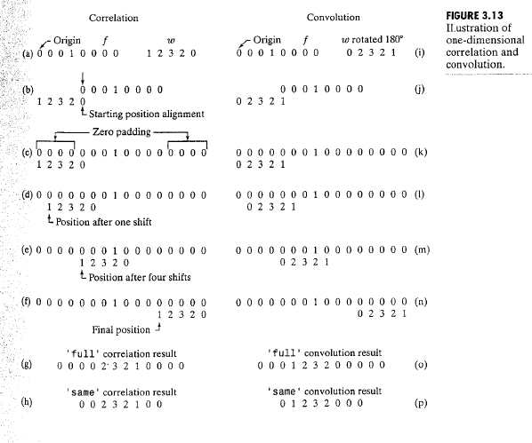

Slide 40
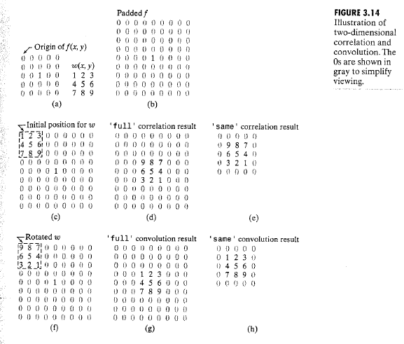

Slide 41
Smoothing Spatial Filters
Averaging filters (Low pass filters )
Smoothing linear filters
Purpose: for blurring and random noise reduction.
Blurring: removal of small details from an image
Averaging results in an image with reduced sharp transitions in intensities.
Edges- characterized by sharp intensity transitions.
Reduction of irrelevant details of an image

Slide 42
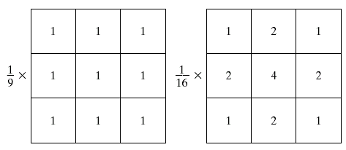
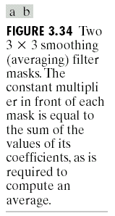
Smoothing Spatial Filters
Box filter
Weighted average filter
Box filter ( Average)
Weighted average

Slide 43
Weighted Smoothing Filters
More effective smoothing filters can be generated by allowing different pixels in the neighbourhood different weights in the averaging function
Pixels closer to the central pixel are more important
Often referred to as a weighted averaging
¹/₁₆ | ²/₁₆ | ¹/₁₆
²/₁₆ | ⁴/₁₆ | ²/₁₆
¹/₁₆ | ²/₁₆ | ¹/₁₆
Weighted averaging filter

Slide 44
Smoothing Spatial Filtering
Origin
x
104
100
108
¹/₉
¹/₉
¹/₉
99
106
98
*
¹/₉
¹/₉
¹/₉
95
90
85
¹/₉
¹/₉
¹/₉
Original Image Pixels
Filter
¹/₉
¹/₉
¹/₉
Simple 3*3 Neighbourhood
104
100
108
3*3 Smoothing Filter
¹/₉
¹/₉
¹/₉
99
106
98
¹/₉
¹/₉
¹/₉
95
90
85
e = ¹/₉*106 + ¹/₉*104 + ¹/₉*100 + ¹/₉*108 + ¹/₉*99 + ¹/₉*98 + ¹/₉*95 + ¹/₉*90 + ¹/₉*85
= 98.3333
y
Image f (x, y)
The above is repeated for every pixel in the original image to generate the smoothed image

Slide 45
Smoothing Spatial Filters
The general implementation for filtering an M X N image with a weighted averaging filter of size m x n is given by
where a=(m-1)/2 and b=(n-1)/2

Slide 47
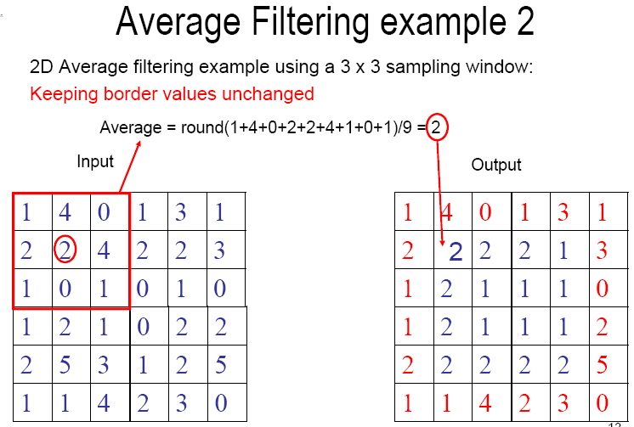

Slide 48
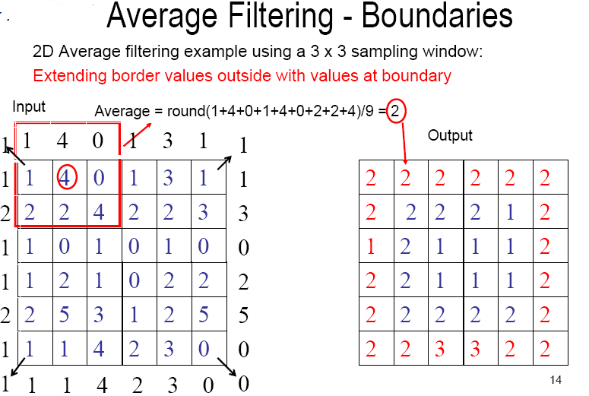

Slide 49
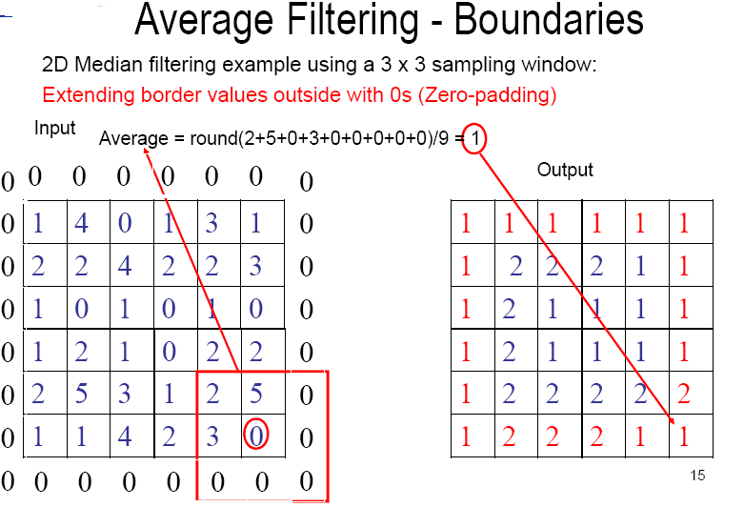

Slide 50
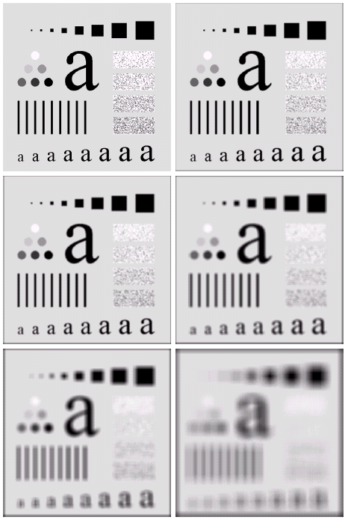
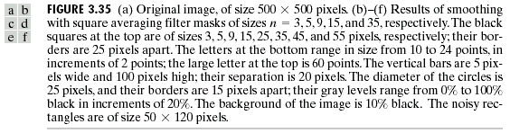
Image smoothing with masks of various sizes

Slide 51
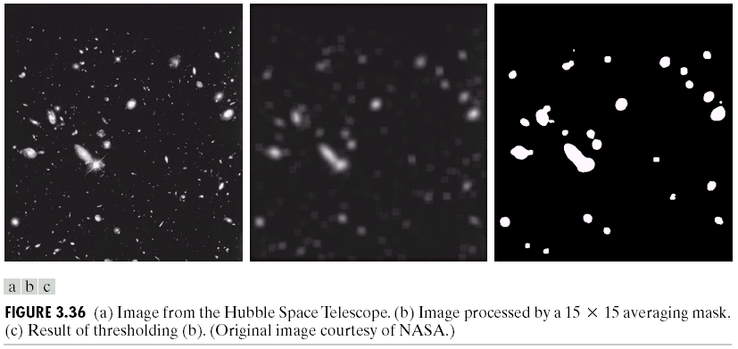
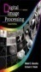
Another Smoothing Example
By smoothing the original image we get rid of lots of the finer detail which leaves only the gross features for thresholding
Images taken from Gonzalez & Woods, Digital Image Processing (2002)
Original Image
Smoothed Image
Thresholded Image
* Image taken from Hubble Space Telescope

Slide 52
Limitations of Averaging filter
1) Averaging operation leads to blurring of an image. Blurring affects feature localization.
2) If the averaging operation is applied to an image corrupted by impulse noise then the impulse noise is attenuated and diffused but not removed.

Slide 53
Order-Statistic Filters
Nonlinear spatial filter.
Response is based on ordering the pixels contained in the image area encompassed by filter,
replacing the value of center pixel with value determined by the ranking result.

Slide 54
Median filtering example

Slide 56
Median filtering example

Slide 57
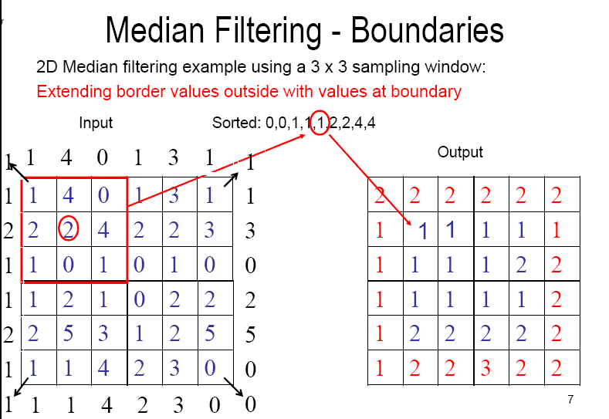

Slide 58
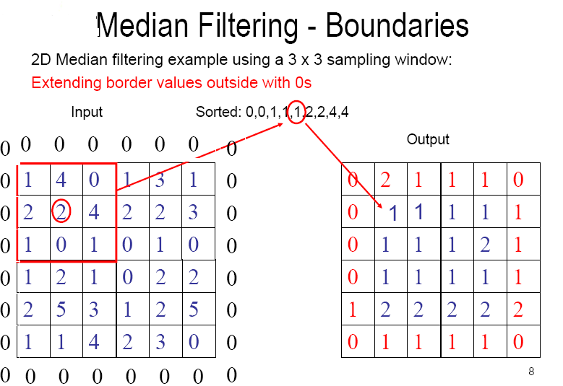

Slide 59
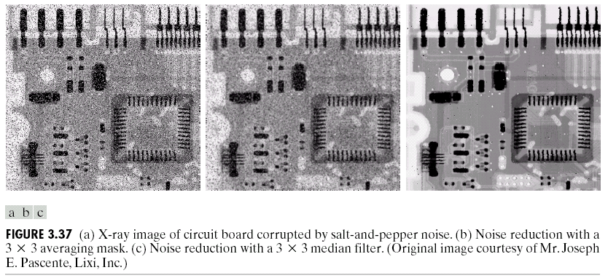
Order-statistic filters:
Median filter: to reduce impulse noise (salt-and-pepper noise)
Original Image With Noise
Image After Averaging Filter
Image After Median Filter
Sometimes a median filter works better than an averaging filter

Slide 60
Sharpening Spatial Filters/ High pass filter
Previously we have looked at smoothing filters which remove fine detail
Sharpening spatial filters seek to highlight fine detail
Remove blurring from images
Highlight edges
Sharpening filters are based on spatial differentiation.
Fundamentally, the strength of response of a derivative operator is proportional to the degree of intensity discontinuity of the image at that point at which the operator is applied. Thus enhances edges and other discontinuity and deemphasizes area with slowly varying intensities.
Notes:
60

Slide 61
Sharpening filters are based on computing spatial derivatives of an image.
The derivative of digital function are defined in terms of differences.
First derivative 1) must be zero in areas of constant intensities
2)must be non0zero at the onset of an intensity step or ramp
3) must be non-zero along ramps.
Second derivative 1) must be zero in areas of constant intensities
2)must be non0zero at the onset and end of an intensity step or ramp
3) must be zero along ramps of constant slope.

Slide 62
Sharpening Spatial Filters
The derivative of digital function are defined in terms of differences.
The first-order derivative of a one-dimensional function f(x) is
The second-order derivative of a one-dimensional function f(x) is

Slide 63
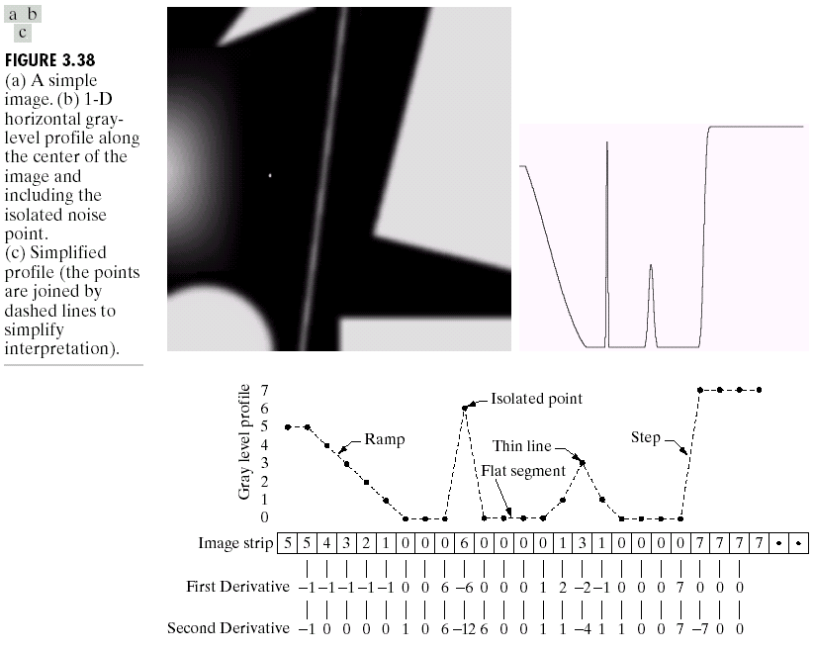

Spatial Differentiation
A
B
Notes:
63

Slide 64
1st and 2nd Derivative
f(x)
f’(x)
f’’(x)

Slide 65
1st Derivative (cont…)
f(x)
5 | 5 | 4 | 3 | 2 | 1 | 0 | 0 | 0 | 6 | 0 | 0 | 0 | 0 | 1 | 3 | 1 | 0 | 0 | 0 | 0 | 7 | 7 | 7 | 7
 | 0 | -1 | -1 | -1 | -1 | -1 | 0 | 0 | 6 | -6 | 0 | 0 | 0 | 1 | 2 | -2 | -1 | 0 | 0 | 0 | 7 | 0 | 0
f’(x)
Notes:
65

Slide 66
2nd Derivative (cont…)
f(x)
5 | 5 | 4 | 3 | 2 | 1 | 0 | 0 | 0 | 6 | 0 | 0 | 0 | 0 | 1 | 3 | 1 | 0 | 0 | 0 | 0 | 7 | 7 | 7 | 7
 | -1 | 0 | 0 | 0 | 0 | 1 | 0 | 6 | -12 | 6 | 0 | 0 | 1 | 1 | -4 | 1 | 1 | 0 | 0 | 7 | -7 | 0 | 0
f’’(x)
Notes:
66

Slide 67
Using Second Derivatives For Image sharpening
The 2nd derivative is more useful for image enhancement than the 1st derivative
Stronger response to fine detail
Simpler implementation
The first sharpening filter is the Laplacian
Approach : defining a discrete formulation of second order derivative and then constructing a filter mask based on formulation
Isotropic filters , whose response is independent of the direction of the discontinuities in the image. OR
Isotropic filters are rotation invariant.
Notes:
67

Slide 68
Simplest isotropic derivative operator-- The Laplacian
Development of the Laplacian method
The two dimensional Laplacian operator for continuous functions:
The Laplacian is a linear operator.

Slide 69
The Laplacian (cont…)
So, the Laplacian can be given as follows:
We can easily build a filter based on this
0
1
0
1
-4
1
0
1
0
Notes:
69

Slide 70
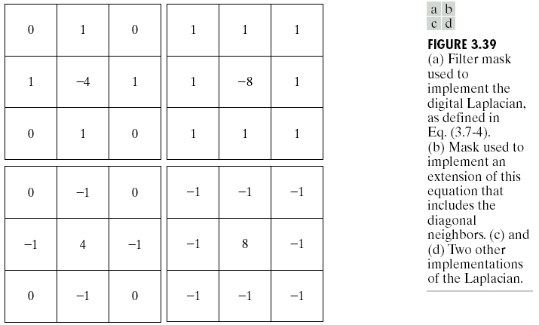
Use of Second Derivatives for Enhancement
The Laplacian

Slide 71
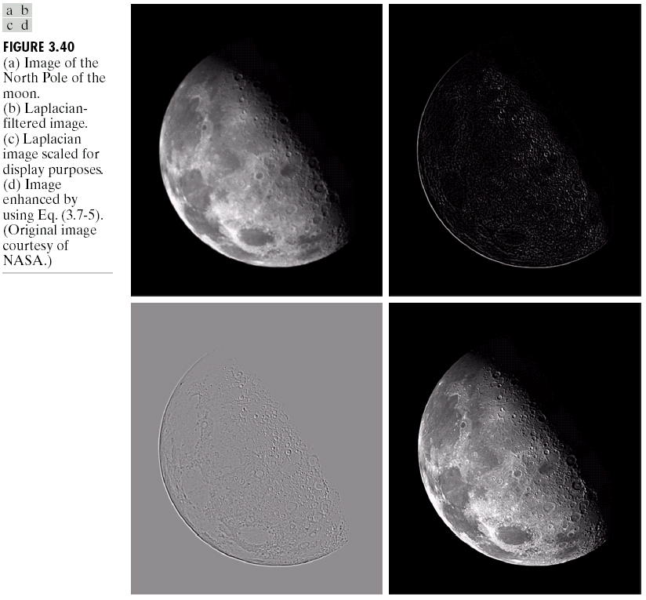
The Laplacian (cont…)
Applying the Laplacian to an image we get a new image that highlights edges and other discontinuities and deemphasize regions with slowly varying intensities. Produce images that have greyish edge lines and other discontinuities , all superimposed on black featureless background.
Images taken from Gonzalez & Woods, Digital Image Processing (2002)
Original Image
Laplacian Filtered Image
Laplacian Filtered Image Scaled for Display
Notes:
71

Slide 72
But That Is Not Very Enhanced!
The result of a Laplacian filtering is not an enhanced image
Subtract the Laplacian result from the original image
to generate our final sharpened enhanced image
Laplacian Filtered Image Scaled for Display
Notes:
72

Slide 73
Laplacian Image Enhancement
-
=
Original Image
Laplacian Filtered Image
Sharpened Image
In the final sharpened image edges and fine detail are much more obvious
Notes:
73

Slide 74
Laplacian Image Enhancement
Notes:
74

Slide 75
Simplified Image Enhancement
The entire enhancement can be combined into a single filtering operation
Notes:
75

Slide 76
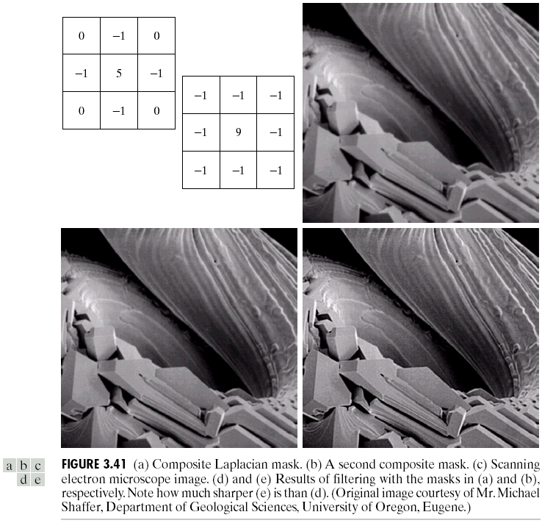
Simplified Image Enhancement (cont…)
0
-1
0
-1
5
-1
Images taken from Gonzalez & Woods, Digital Image Processing (2002)
0
-1
0
This gives us a new filter which does the whole job for us in one step
Notes:
76

Slide 77
Simplified Image Enhancement (cont…)
Images taken from Gonzalez & Woods, Digital Image Processing (2002)
Notes:
77

Slide 78
Variants On The Simple Laplacian
There are lots of slightly different versions of the Laplacian that can be used:
0
1
0
1
1
1
Simple Laplacian
Variant of Laplacian
1
-4
1
1
-8
1
0
1
0
1
1
1
Images taken from Gonzalez & Woods, Digital Image Processing (2002)
-1
-1
-1
-1
9
-1
-1
-1
-1
Notes:
78

Slide 79
Unsharp Masking & Highboost Filtering
Using sequence of linear spatial filters in order to get Sharpening effect.
Blur the original image
Subtract the blurred version from the original (this is called the mask)
-add resulting mask to original image
Notes:
79

Slide 80
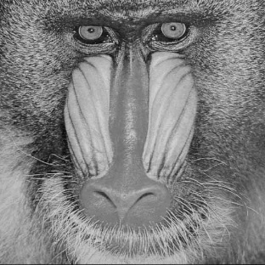
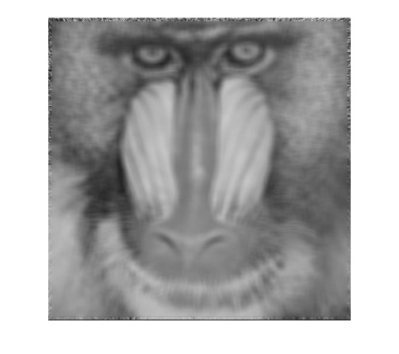
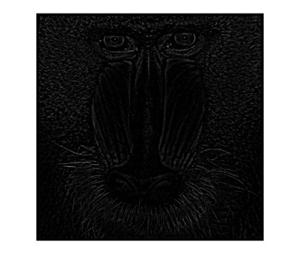
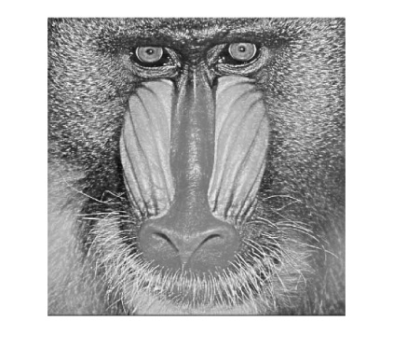
Unsharp Masking & Highboost Filtering
Avg.
₋
₊
₊
K<1 de-emphasize the contribution of the unsharp mask

Slide 81
Example of unsharp masking

Slide 83
1st Derivative for image sharpening – The Gradient
An image gradient is a directional change in the intensity or color in an image. Image gradients may be used to extract information from images.
The derivative of an image can be computed using the magnitude of gradient.
For a function f(x, y) the gradient of f at coordinates (x, y) is given as the column vector:
Notes:
83

Slide 85
Magnitude: provides information about edge strength
Direction: Perpendicular to the direction
of the edge.
For practical reasons this can be simplified as:

Slide 86
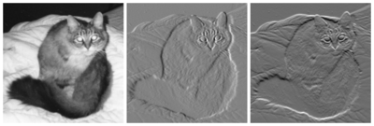
On the left, an intensity image of a cat. In the center, a gradient image in the x direction measuring horizontal change in intensity. On the right, a gradient image in the y direction measuring vertical change in intensity. Gray pixels have a small gradient; black or white pixels have a large gradient.

Slide 88
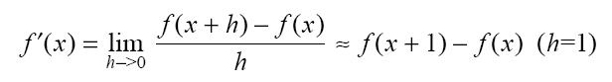
Approximate gradient using finite differences:
sensitive to vertical edges
Δx
sensitive to horizontal edges

Slide 89
All the derivative masks should have the following properties:
Opposite sign should be present in the mask.
Sum of mask should be equal to zero.
More weight means more edge detection.

Slide 90
We can implement and using masks:
Example: approximate gradient at z₅
good approximation
at (x+1/2,y)
(x+1/2,y)
(x,y+1/2)
*
*
good approximation
at (x,y+1/2)

Slide 91
Roberts cross –gradient operators
A different approximation of the gradient:
good approximation
(x+1/2,y+1/2)
*
We can implement and using the following masks

Slide 92
Example: approximate gradient at z₅
Other approximations
Sobel

Slide 93
1st Derivative Filtering (cont…)
Other approximations
There is some debate as to how best to calculate these gradients but we will use:
which is based on these coordinates
z₁
z₂
z₃
z₄
z₅
z₆
z₇
z₈
z₉
Notes:
93

Slide 94
Sobel Operators
Based on the previous equations we can derive the Sobel Operators
To filter an image it is filtered using both operators the results of which are added together
-1
-2
-1
-1
0
1
0
0
0
-2
0
2
1
2
1
-1
0
1
Notes:
94

Slide 95
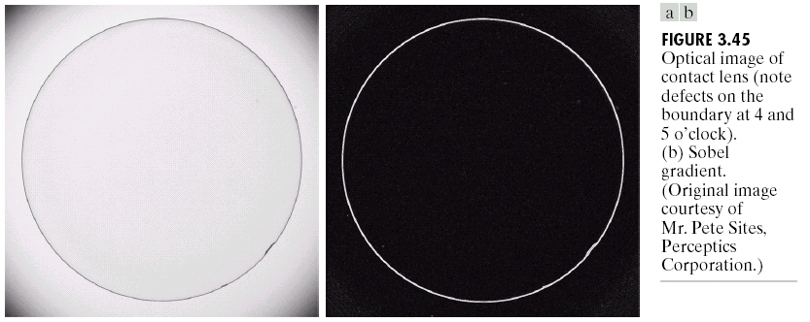
Sobel Example
An image of a contact lens which is enhanced in order to make defects (at four and five o’clock in the image) more obvious
Sobel filters are typically used for edge detection
Images taken from Gonzalez & Woods, Digital Image Processing (2002)
Notes:
95

Slide 96
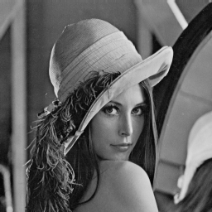
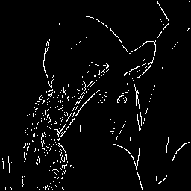
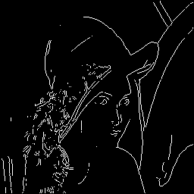
Roberts
Sobel

Slide 97
1st & 2nd Derivatives
Comparing the 1st and 2nd derivatives we can conclude the following:
1st order derivatives generally produce thicker edges
2nd order derivatives have a stronger response to fine detail e.g. thin lines
1st order derivatives have stronger response to grey level step
2nd order derivatives produce a double response at step changes in grey level
Notes:
97

Slide 98
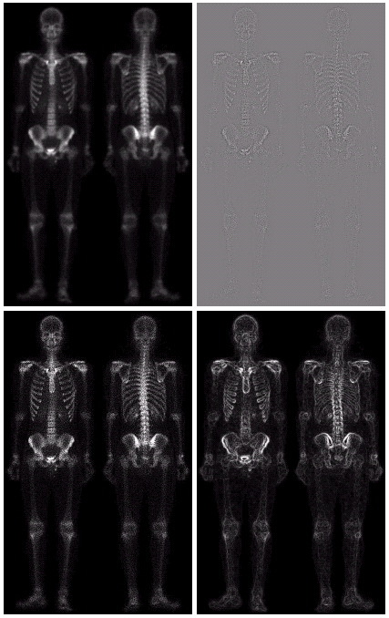
Combining Spatial Enhancement Methods (cont…)
(a)
Images taken from Gonzalez & Woods, Digital Image Processing (2002)
Laplacian filter of bone scan (a)
(b)
Sharpened version of bone scan achieved by subtracting (a) and (b)
(c)
Sobel filter of bone scan (a)
(d)
Notes:
98

Slide 99
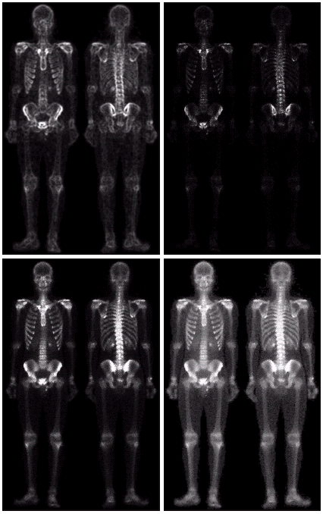
Combining Spatial Enhancement Methods (cont…)
Result of applying a power-law trans. to (g)
(h)
Sharpened image which is sum of (a) and (f)
(g)
The function of (c) minus (e) which will be used as a mask
(f)
(e)
Images taken from Gonzalez & Woods, Digital Image Processing (2002)
Image (d) smoothed with a 5*5 averaging filter
Notes:
99

Slide 100
Combining Spatial Enhancement Methods (cont…)
Compare the original and final images
Images taken from Gonzalez & Woods, Digital Image Processing (2002)
Notes:
100

Slide 101
Histogram Processing What is Histogram?
In Statistics, Histogram is a graphical representation showing a visual impression of the distribution of data.
An Image Histogram is a type of histogram that acts as a graphical representation of the lightness/color distribution in a digital image.
It plots the number of pixels for each value.

Slide 102
Introductory Example of Histograms
The (intensity or brightness) histogram shows how many
times a particular grey level (intensity) appears in an image.
For example, 0 - black, 7 – white
0 | 1 | 1 | 2 | 4
2 | 1 | 0 | 0 | 2
5 | 2 | 0 | 0 | 4
1 | 1 | 2 | 4 | 1
image
histogram

Slide 103
Why Histogram?
Histograms are the basis for numerous spatial domain processing techniques.
Histogram manipulation can be used effectively for image enhancement.
Histograms can be used to provide useful image statistics.
Information derived from histograms are quite useful in other image processing applications, such as image compression and segmentation.

Slide 104
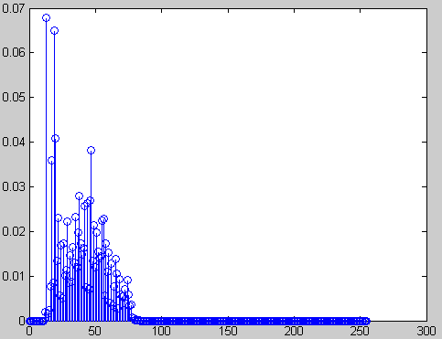
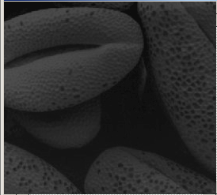
Some Typical Histograms
The shape of a histogram provides useful information for contrast enhancement.
Dark image
The horizontal axis of each histogram plot corresponds to gray level values, r_{k}.
The vertical axis corresponds to values of h(r_{k})=n_{k} or p(r_{k})=n_{k}/n if the values are normalized.

Slide 105
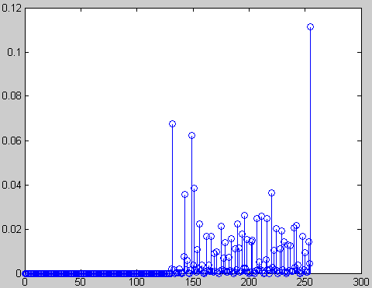



Bright image
Low contrast image

Slide 106


High contrast image

Slide 107

Why Histogram equalization?
It is a baby in the cradle!
Histogram information reveals that image is under-exposed

Slide 108

Another Example
Over-exposed image

Slide 109

Histogram Processing
1
4
5
0
3
1
5
1
Types of processing:
Histogram equalization
Histogram matching (specification)
Number of Pixels
gray level

Slide 110
Histogram Equalization Example:
Histogram of an image represents the relative frequency of occurrence of various gray levels in the image
T
We are looking for
this transformation !

Slide 111
Histogram Equalization
Basic idea: find map f(x) such that the histogram of the modified (equalized) image is flat (uniform).
Preprocessing technique to enhance contrast in ‘natural’ images.
Target: find gray level transformation function T to transform image f such that the histogram of T(f) is ‘equalized’

Slide 112
Histogram equalization:
Let us assume for the moment that the input image to be enhanced has continuous gray values, with r = 0 representing black and r = L-1 representing white.
0 ≤ r ≤ L-1
The approach is to design a transformation T(.) such that the gray values in the output is uniformly distributed in [0, L-1].
We need to design a gray value transformation s = T(r), based on the histogram of the input image, which will enhance the image.

Slide 113
we assume that:
(1) T(r) is a monotonically increasing function for 0 ≤ r ≤ L-1
(preserves order from black to white).
(2) T(r) maps [0, L-1] into [0, L-1] (preserves the range of allowed
Gray values).
Ιnverse transformation r = T ⁻¹(s) .
(1)’ T(r) is strictly monotonically increasing function for 0 ≤ r ≤ L-1

Slide 114
Let p_{r}(r) and p_{s}(s) --- the probability density of the Gray values in the input and output images.

Slide 115
• If p_{r}(r) and T(r) are known, and r = T ⁻¹(s) satisfies condition 1, we can write (result from probability theory):
One way to enhance the image is to design a transformation function T(.) such that the gray values in the output is uniformly distributed in [0,L- 1],
i.e. p_{s} (s) = L-1, 0 ≤ s ≤L-1

Slide 116
•Consider the transformation function
• Note that this is the cumulative distribution function (CDF) of r and satisfies the previous two conditions.
From the previous equation and using the fundamental
theorem of calculus,

Slide 117
Put (3) in (1) we get,
0 ≤ s ≤L-1
Thus, using a transformation function equal to the CDF of input gray values r, we can obtain an image with uniform gray values.

Slide 118
Histogram Processing
The histogram of a digital image with gray levels from 0 to L-1 is a discrete function h(r_{k})=n_{k}, where:
r_{k} is the kth gray level
n_{k} is the # pixels in the image with that gray level
n is the total number of pixels in the image
k = 0, 1, 2, …, L-1
Normalized histogram: p(r_{k})=n_{k}/n n=MN
Thus, p(r_{k}) gives an estimate of the probability of occurrence of gray level r_{k}.
sum of all components = 1

Slide 119
How to implement histogram equalization?
Step 1:For images with discrete gray values, compute:
L: Total number of gray levels
n_{k}: Number of pixels with gray value r_{k}
n: Total number of pixels in the image
Step 2: Based on CDF, compute the discrete version of the previous transformation :

Slide 120

Example:
• Consider an 8-level 64 x 64 image with gray values (0, 1, …,7). The normalized gray values are (0, 1/7, 2/7, …, 1). The normalized histogram is given below:
NB: The gray values in output are also (0, 1/7, 2/7, …, 1).

Slide 121




# pixels
Fraction of # pixels
Gray value
Normalized gray value

Slide 122


Histogram of output image
# pixels
Gray values
• Note that the histogram of output image is only approximately, and not exactly, uniform. This should not be surprising, since there is no result that claims uniformity in the discrete case.

Slide 123


Example
Original image and its histogram

Slide 124



Histogram equalized image and its histogram

Slide 125


• Comments:
Histogram equalization may not always produce desirable results, particularly if the given histogram is very narrow. It can produce false edges and regions. It can also increase image “graininess” and “patchiness.”

Slide 126




Slide 127

Histogram Equalization

Slide 128


Histogram Specification
desired
G
equalize
equalize
-1
G

Slide 129
Histogram Specification(Histogram Matching)
Histogram equalization yields an image whose pixels are (in theory) uniformly distributed among all gray levels.
Sometimes, this may not be desirable. Instead, we may want a transformation that yields an output image with a pre-specified histogram. This technique is called histogram specification.

Slide 130
Given Information
(1) Input image from which we can compute its histogram .
(2) Desired histogram.
Goal
Derive a point operation, H(r), that maps the input image into an output image that has the user-specified histogram.
Again, we will assume, for the moment, continuous-gray values.

Slide 131
Approach of derivation
z=H(r)
Input image
Uniform image
Output image
s=T(r)
v=G(z)

Slide 132
Suppose, the input image has probability density in p(r) . We
want to find a transformation z = H (r) , such that the probability density of the new image obtained by this transformation is p_{out}(z) , which is not necessarily uniform.
First apply the transformation
This gives an image with a uniform probability density.
If the desired output image were available, then the following
transformation would generate an image with uniform density:

Slide 133
From the gray values ν we can obtain the gray values z by using the inverse transformation, z = G⁻¹(v)
Z=H(r)= G⁻¹[ v=s =T(r)]

Slide 134
For discrete gray levels, we have

Slide 135
Algorithm for histogram specification:
(1) Equalize input image to get an image with uniform gray values, using the discrete equation:
(2) Based on desired histogram to get an image with uniform gray values, using the discrete equation:

Slide 136
Example:
• Consider an 8-level 64 x 64 previous image.
# pixels
Gray value

Slide 137


• It is desired to transform this image into a new image, using a transformation Z=H(r)= G⁻¹[T(r)], with histogram as specified below:
# pixels
Gray values

Slide 138

• The transformation T(r) was obtained earlier (reproduced below):
• Now we compute the transformation G as before.

Slide 139




Original image and its histogram
Histogram specified image and its histogram

Slide 140


Slide 141


Slide 142


Slide 143


Slide 144


Slide 145


Slide 146


Slide 147


Slide 148


Slide 149


Slide 150


Slide 151


